Slide 1
PRIVATE TRUSTS UNDER THE NIGERIA TAX ACT 2025: TAX IMPLICATIONS AND PROFESSIONAL ADVISORY OPPORTUNITIES
BY AKIN AKINDELE, ESQ., FCTI.

Slide 2
INTRODUCTION
Trust or Settlement has evolved and is no longer limited to Estate Planning, wealth preservation, family succession, or asset protection. The reality now is every trust created has tendencies of tax implications.
As Tax Professionals we must keep abreast of the aforementioned to save our clients from avoidable tax liabilities, penalties, double taxation, trust litigation, and even personal liabilities of Trustees because a Trustee holds a fiduciary responsibilities or duties to the Settlor and by extension to the beneficiary.

Slide 3
WHY TAX PROFESSIONALS MUST UNDERSTAND TAXATION OF TRUSTS
Taxation affects Trust structure e.g corporate or non-corporate trust, choice of Trustee, jurisdiction e.g offshore trust, distribution strategy, investment decisions, and succession planning.
Therefore, it is pertinent to note that our job starts from when the Client conceives the idea and while drafting the Trust deed as poor tax planning and drafting can expose the Trust to unnecessary and avoidable taxes.

Slide 4
LEARNING OBJECTIVE
- Taxation of trusts under the Nigeria Tax Act 2025
- Taxation of trustees
- Taxation of beneficiaries
- Taxation of settlor under revocable trust
- Tax planning opportunities
- Practical compliance requirements

Slide 5

DEFINITION OF TERMS
TRUST: Simply put is a legal arrangement where one party (the Trustee) holds, manages, and controls assets on behalf of another (the Settlor) for the benefit of (the Beneficiary)
TRUSTEE: This is the individual or corporate entity (e.g., a registered trust company) managing the asset or property.
BENEFICIARY: This is the party receiving the actual benefit or income from the trust assets.

Slide 6
DEFINITION OF KEY TERMS
SETTLOR: This is the individual or entity transferring the assets.
TRUST DEED: This is a written legal document by which the Trust is created.
TAX: is defined according to the National Tax Policy as any compulsory payment to the government imposed by law.

Slide 7
LEGAL FRAMEWORK
- Nigeria Tax Act 2025
Nigeria Tax Administration Act 2025
Trustee Investment Act
Companies And Allied Matters Act 2020
Administration of Estates Laws etc

Slide 8
STATUTORY ANCHORS AND JURISDICTIONAL SCOPE UNDER NTA 2025
Section 16 and the fifth schedule of the Nigeria Tax Act 2025 fundamentally restructured tax administration of Trusts in Nigeria.
Section 16 of the NTA 2025: Provides that “the income of an individual, trustee, or estate of a deceased person, made, created or administered in or outside Nigeria, shall be ascertained in accordance with the provisions of the Fifth Schedule to this Act.”

Slide 9
TAX IMPICATIONS/OBLIGATIONS FOR SETTLORS, TRUSTEES, AND THE BENEFICIARIES.
Examples of income of Trusts are : rental income, dividend, royalties, capital appreciation, interest, business income, professional income etc.
The Fifth Schedule of the NTA 2025 represents the legal framework for trust taxation. It stipulates rules guiding: computation, deductions, apportionment, beneficiaries, residual income, as well as trustee assessments.

Slide 10
TAX IMPICATIONS/OBLIGATIONS FOR SETTLORS, TRUSTEES, AND THE BENEFICIARIES
Ordinarily, Chapter 2 of the NTA 2025- Taxation of Income Of Persons
Applies to taxation of Trusts while the Fifth schedule dealt with the peculiarities of Trusts.
SCENARIO 1:
1st step: Income is computed
2nd step: Necessary deductions are made in line with the Trust deed
3rd step: Net income is distributed to the beneficiaries

Slide 11
TAX IMPICATIONS/OBLIGATIONS FOR SETTLORS, TRUSTEES, AND THE BENEFICIARIES
Beneficiaries are taxed in accordance with the provisions of the NTA 2025
SCENARIO 2: UNDISTRIBUTED INCOME
Trustee is taxed in representative capacity in line with the provisions of NTA 2025
Note that Corporate Trustee would be taxed 30% if it is a large Company in line with the provisions of NTAA 2025

Slide 12
TAX IMPICATIONS/OBLIGATIONS FOR SETTLORS, TRUSTEES, AND THE BENEFICIARIES
SCENARIO 3: RESIDUAL INCOME
This simply means trust income that is left after expenses, distribution, and allowable deductions have been taken care of.
In this case, residual income would be taxed in the hands of the Trustee in a representative capacity in line with the dictates of the Fifth schedule.

Slide 13
TAX IMPICATIONS/OBLIGATIONS FOR THE SETTLOR,
Revocable or Irrevocable Trust:
1. Retained Control/Revocability: If you create a revocable trust or retain explicit powers of control (such as the ability to revoke the trust, direct asset allocations, or alter beneficiaries), the tax authorities will look right through the trust. The income generated by the trust assets will be attributed back to you and taxed directly in your hands at ordinary personal income tax rates up to 25%.

Slide 14
TAX IMPICATIONS/OBLIGATIONS FOR THE SETTLOR,
2. Irrevocable Trust: The Settlor is not oblige to pay tax under this arrangement. However, there is a proviso.
3. Minor Children Distributions: If trust income is distributed to your unmarried minor child and exceeds the national minimum wage, it is attributed back to you as the settlor and added to your taxable income.

Slide 15
TAX IMPICATIONS/OBLIGATIONS FOR THE SETTLOR.
Worldwide Income Exposure
If you are a Nigerian-resident settlor, the NTA 2025 expands scrutiny to worldwide income. Setting up an offshore or foreign trust no longer shields the underlying income from the Nigerian tax net.
The most significant change under the Fifth Schedule of the NTA 2025 is the robust anti-avoidance "look-through" framework

Slide 16
SOME SALIENTS FEATURES OF THE FIFTH SCHEDULE
3. Corporate v Non Corporate Trusts: Corporate trusts are subjected to the standard 30% corporate rate, while non-corporate trusts are taxed at progressive individual rates.
4. Capital Gains Tax (CGT) and Asset Dispositions:
The former Capital Gains Tax Act has been substantially repealed and consolidated into the NTA 2025.
Capital gains realized on the disposal of trust assets are no longer shielded by a separate 10% rate. They are treated as ordinary income.

Slide 17
SOME SALIENTS FEATURES OF THE FIFTH SCHEDULE
- Share Disposals: NTA 2025 exempts gains on share disposals if total proceeds are below ₦150 million and chargeable gains do not exceed ₦10 million in a 12-month period (provided proceeds are reinvested within Nigeria).

Slide 18
SOME SALIENTS FEATURES OF THE FIFTH SCHEDULE
6. Double Taxation Risk and Personal Liability:
Double Taxation Risk: Under the Fifth Schedule of the NTA 2025, any income retained or left as residual income in the hands of the trustee is assessed and taxed directly to the trustee. If that same income is later distributed or accounted for in a subsequent cycle without proper reconciliation against prior trustee-level assessments, the income risks being taxed twice—first in the trustee's hands as residual income and again when distributed.
- Personal Liability: Trustees bear legal and financial liability for unpaid taxes, penalties, and non-compliance.

Slide 19
TAX PLANNING OPPORTUNITIES FOR TAX PROFESSIONALS
1. Discretionary Income-Splitting Clause: This allows trustees to distribute income among multiple beneficiaries to keep them within lower tax bands (e.g., 0% or 15%), rather than making a lump-sum distribution to one beneficiary, which could trigger the 25% rate
2. Capitalizing Allowable Deductions: Tax Professionals must ensure all eligible trust expenses (e.g., trustee administrative fees, fixed annuities) are fully deducted before computing taxable trust income.
3. Deed Drafting: Drafting Trust deeds to explicitly mandate the accumulation of income or explicitly map out the timing of distributions to optimize the provisions of the NTA and NTAA 2025

Slide 20
TAX PLANNING OPPORTUNITIES FOR TAX PROFESSIONALS
4. Share Reinvestment & Capital Gains Optimization Clause: The NTA 2025 treating capital gains as ordinary income means asset sales are taxed at up to 25% (individuals) or 30% (corporate trustees). This clause mandates trustees to exploit exemptions, such as the ₦150 million share proceeds exemption, by exploring automatic domestic reinvestment

Slide 21
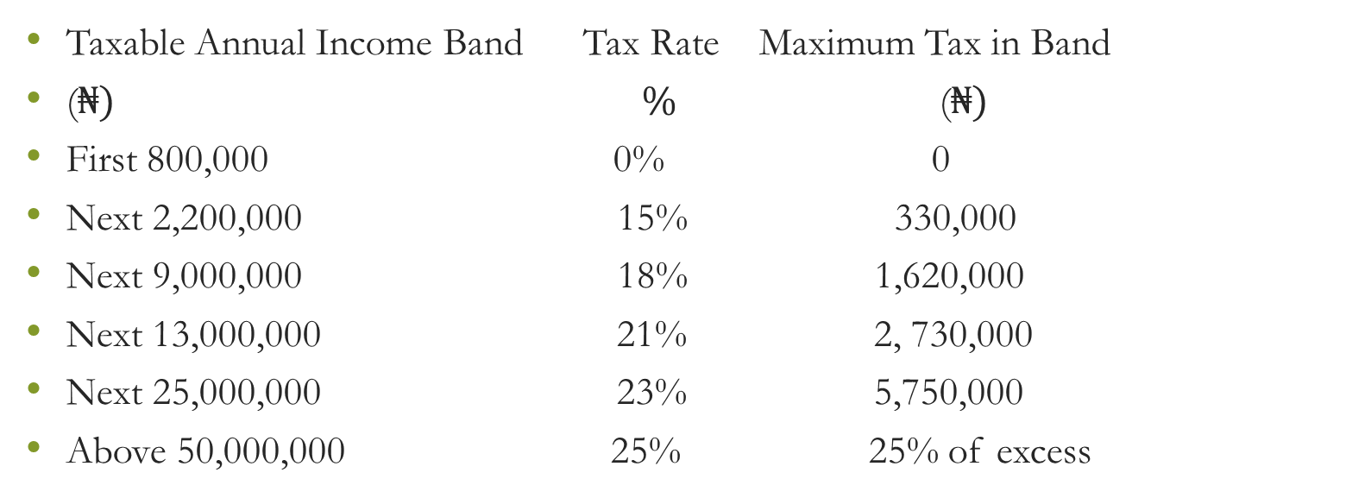
PROGRESSIVE TAX RATE (NTA 2025)
Taxable Annual Income Band Tax Rate Maximum Tax in Band
($₦)\text{ \% }$($₦)$
First 800,000 0% 0
Next 2,200,000 15% 330,000
Next 9,000,000 18% 1,620,000
Next 13,000,000 21% 2, 730,000
Next 25,000,000 23% 5,750,000
Above 50,000,000 25% 25% of excess

Slide 22
CONCLUSION
The role of taxation in Private Trusts is germane and cannot be over emphasized. The new tax reform is in force and it is largely in compliance with global best practices.
In conclusion, let us remember that there is a lot of money on the table for Tax Professionals under this new regime if we advise our clients better and professionally. It is high time we positioned ourselves for the harvest.

Slide 23
APPRECIATION
Thank you for your time.
Akin Akindele, Esq, FCTI.

