Slide 1

BEYOND THE BOARDROOM
Digital-First Networking &
Cross-Generational Leadership in Tax
Society of Women in Taxation
15 October 2026 · 11:30 AM
A conversation for women tax practitioners —
Youth & Millennials leading the next chapter

Slide 2


Slide 3

A STORY TO BEGIN
The comment that changed everything
Three years ago, Amina, a young tax associate, posted a thoughtful comment on a LinkedIn article about digital tax administration. She didn’t expect much.
Within 48 hours, a senior partner at a Big Four firm replied. A virtual coffee followed. Six months later, Amina led a cross-border digital transformation project and mentored two interns she had never met in person.
That single digital interaction opened doors the traditional boardroom never would have. Today we explore how every woman in this room can create and open those doors.

Slide 4
TODAY’S JOURNEY
What we will explore together
01
The Shift
Why the boardroom is no longer enough
02
Digital-First Networking
Building real relationships in virtual spaces
03
Cross-Generational Leadership
Strengths of Youth & Millennial tax professionals
04
Practical Bridges
Strategies that work across generations
05
Your Next Move
Clear actions you can take this week

Slide 5
THE SHIFT
Beyond the boardroom is not optional — it is the new standard
THEN
NOW
Networking happened in closed rooms and after-work events
Access depended on proximity and seniority
Leadership was often hierarchical and linear
Visibility required physical presence
Influence is built in digital spaces and hybrid communities
Access is created through value and consistency
Leadership is collaborative, adaptive and shared
Visibility is earned through contribution and connection

Slide 6

DIGITAL-FIRST NETWORKING
Not just “being online” — intentionally building relationships that matter
Presence · Value · Depth · Authenticity
Presence
Value
Depth
Authenticity
Show up consistently where tax and other professional conversations are happening.
Share insights, ask questions, celebrate others. Give first.
Turn comments into conversations and then into collaboration.
Lead with curiosity, courage and genuine care.

Slide 7

WHERE THE WORK HAPPENS
Platforms that matter for tax practitioners
LinkedIn
Your professional living room. Post insights, engage with policy and practice content, and comment with substance.
Virtual Communities
Groups like the Society of Women in Taxation, tax tech forums, and WhatsApp circles show up and contribute.
Webinars & Panels
Attend, ask questions, follow up with speakers and fellow attendees. Visibility compounds.
Mentorship Platforms
Formal and informal matching. Offer reverse mentoring; seek sponsors as well as mentors.

Slide 8
FROM CONNECTION TO RELATIONSHIP
Five moves that turn digital contact into real influence
1
Comment with care
Add insight or a genuine question, not just “Great post!”
2
Follow up privately
A short, specific message after public engagement builds trust.
3
Offer value first
Share a resource, introduce someone, or amplify their work.
4
Schedule the next step
Propose a 15-minute virtual coffee with a clear purpose.
5
Stay consistent
Relationships compound. Check in quarterly without an ask.

Slide 9

CROSS-GENERATIONAL LEADERSHIP
Leadership is no longer one-size-fits-all — and that is our advantage
Youth & Millennial professionals + experienced colleagues = stronger tax teams
Shared Purpose
Complementary Strengths
Mutual Mentorship
Both generations want meaningful work and ethical impact in tax systems.
Digital agility + institutional wisdom creates better client and policy outcomes.
Reverse mentoring is real: tech fluency one way, strategic sponsorship the other.

Slide 10
STRENGTHS IN THE ROOM
What Youth & Millennial tax professionals uniquely bring
YOUTH (Gen Z)
MILLENNIALS
▸ Native digital fluency & platform intuition
▸ Bridge between analog and digital eras
▸ Comfort with rapid change and experimentation
▸ Experience navigating hybrid careers
▸ Strong values around equity and transparency
▸ Strong collaborative and coaching skills
▸ Fresh eyes on outdated processes
▸ Proven resilience through economic shifts
▸ Energy for advocacy and community building
▸ Desire for purpose-driven leadership

Slide 11
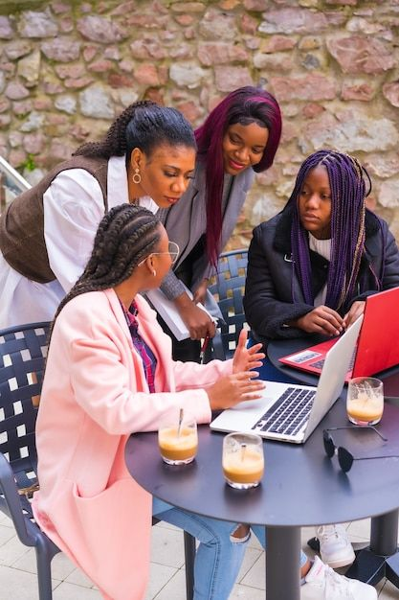
BRIDGING THE GENERATIONS
Practical ways to lead and learn across ages in tax practice
Create mixed project teams
Pair digital-native talent with experienced technical reviewers.
Normalize reverse mentoring
Invite juniors to teach seniors about tools and platforms.
Share the microphone
Co-present at sessions. Visibility builds credibility both ways.
Document the “why”
Senior knowledge + junior curiosity produces clearer processes.
Celebrate different paces
Design workflows that respect deep focus and rapid iteration.
Build psychological safety
Make it safe to ask “basic” questions and challenge assumptions.

Slide 12
LEADERSHIP THAT TRAVELS
Strategies that work whether you are 26 or 42
Lead with curiosity
Make others visible
1
2
Ask better questions than you give answers.
Amplify colleagues — especially quieter voices. Sponsorship is leadership.
Model digital professionalism
Protect focus time
3
4
How you show up online teaches the next generation.
Deep work still matters in tax. Protect it for yourself and teams.
Stay learner-ready
Build community, not just contacts
5
6
Tax, technology and expectations change. The best leaders remain students.
Genuine relationships outlast any single role or firm.

Slide 13

IN PRACTICE
What this looks like in the daily life of a tax professional
Small consistent actions compound into powerful networks and leadership presence
Start the week with intention
Own one niche insight
20 minutes of thoughtful engagement on LinkedIn or a professional group.
Become known for a specific area - transfer pricing tech, ESG tax, or digital services tax.
Host micro-conversations
Document and share
A 15-minute virtual coffee once a fortnight compounds over a year.
Turn a client lesson into a short post. Teaching is the highest form of networking.

Slide 14
KEY TAKEAWAYS
Remember these five truths
01
The boardroom is no longer the only or even the primary place where influence is built.
02
Digital-first networking rewards consistency, value and authenticity over volume.
03
Youth and Millennial strengths are strategic assets, not soft skills to be managed.
04
Cross-generational leadership is a mutual exchange — mentoring flows in both directions.
05
Your next opportunity may begin with a single thoughtful comment or a 15-minute coffee.

Slide 15

YOUR NEXT MOVE
Three commitments you can make today
1
This week
Engage meaningfully with three posts or people. No empty likes, real contribution.
2
This month
Schedule two virtual coffees, one with someone more senior, one earlier in their journey.
3
This quarter
Share one piece of original insight (a short post, a panel contribution, or an internal session).

Slide 16

LET’S TALK
A question for the room
Where have you already seen digital connection open a door that the traditional boardroom could not — and what made that moment possible?

Slide 17

The future of tax leadership
is already in this room.
Go beyond the boardroom.
Build the connections. Lead across generations.
And open the next door for yourself and for someone else.
Thank you
Society of Women in Taxation · 15 October 2026

